Slide 1


Evaluating and Analyzing Global Terrorism

Slide 2
Team Work:
Amr Mohamed AlAlwani
ID:20221367672
Youssef Osama Hamdi
ID:20221372564
Gaser Ezzat Abdulaziz Abu Al-Azm
ID:20221442258
Mahmoud Yasser Abdel Razek Rizk
ID:20221372316
Muhammad Ibrahim Al-Sayed Nofal
ID:20221367676

Slide 3

Introduction
The Global Terrorism Database (GTD) is a database that contains information on terrorist attacks worldwide from 1970 to 2017, which includes over 180,000 incidents. The GTD is an open-source database that is maintained by researchers at the National Consortium for the Study of Terrorism and Responses to Terrorism , The database provides a systematic and comprehensive approach to collecting and analyzing data on both domestic and international terrorist incidents. Understanding the context of the GTD is essential for researchers, analysts, and policymakers to identify trends, patterns, and other insights that can inform counterterrorism efforts.

Slide 4
About Data Set
This Dataset Contains 180,000 row and 135 column showing the lots of information about the Evaluating and Analyzing Global Terrorism
during 1970 to 2017

Slide 5
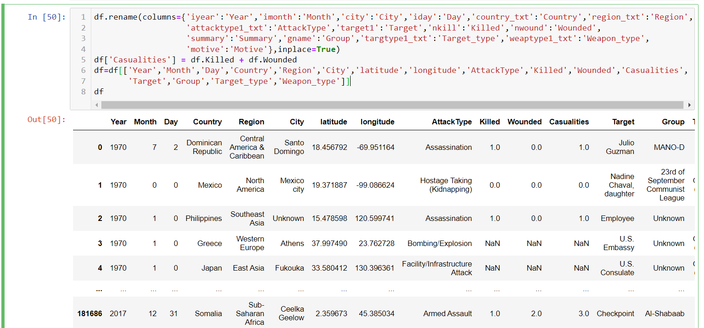
Problem
In data set we hava useless columns , so we select only columns we need and Create a new column named “Casualities” by combining the Killed column with the Wonded column.

Slide 6





Data Cleaning
The data was very messy and we had to clean the data

Slide 7
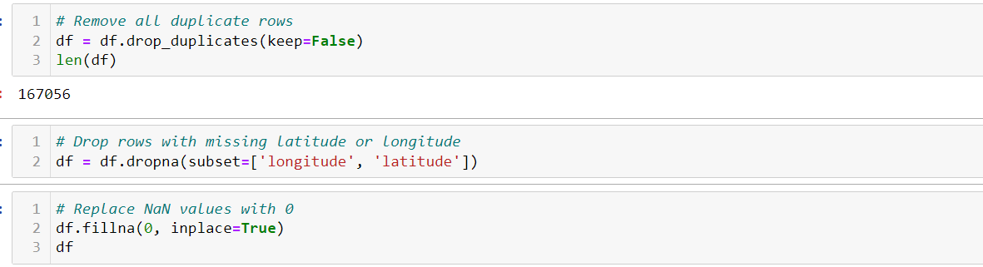
Data Cleaning
First remove all duplicate rows
second Drop rows with missing latitude or longitude
Third Replace NaN values with 0

Slide 8
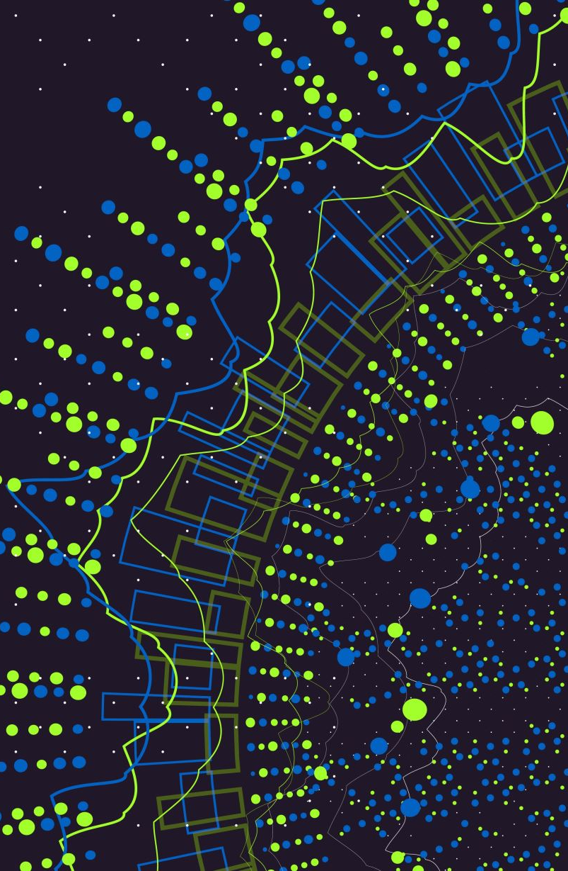
visualization

Slide 9
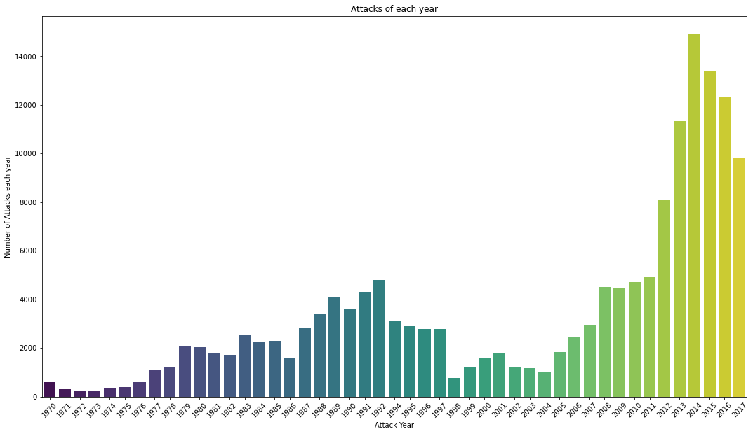
Here we used the barplot for the visualization of (Number Of Attacks For Each Year) to compare their values. The years on the x-axis while values on y-axis. We can find that latest years we have a lot more of terror attacks.

Slide 10
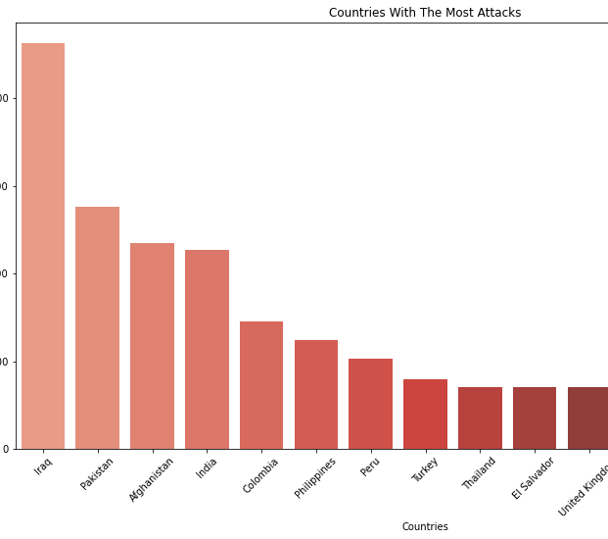
Here again we used the barplot for visualization of the (Countries With The Most Attacks) to see the differences between the values each country has For Example (Iraq) had the most terrorism attacks and pakistan in the 2nd place. the name of the country is on the x-axis while count of the attacks on y-axis.

Slide 11
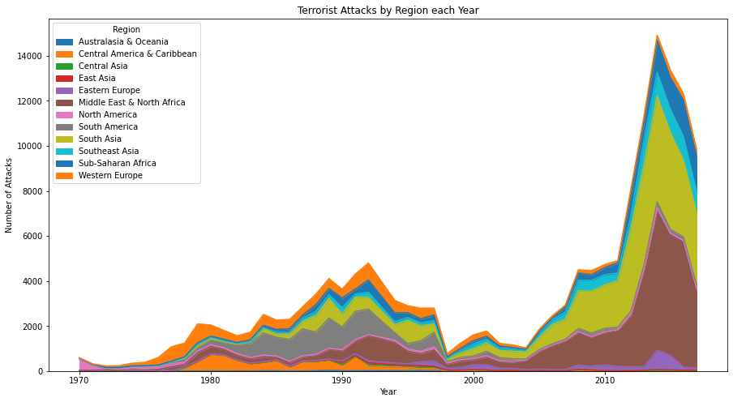
We plotted the Relation between (Attacks happened each year) with the (region) it happened at using 'area' plot for good frequency plotting.

Slide 12
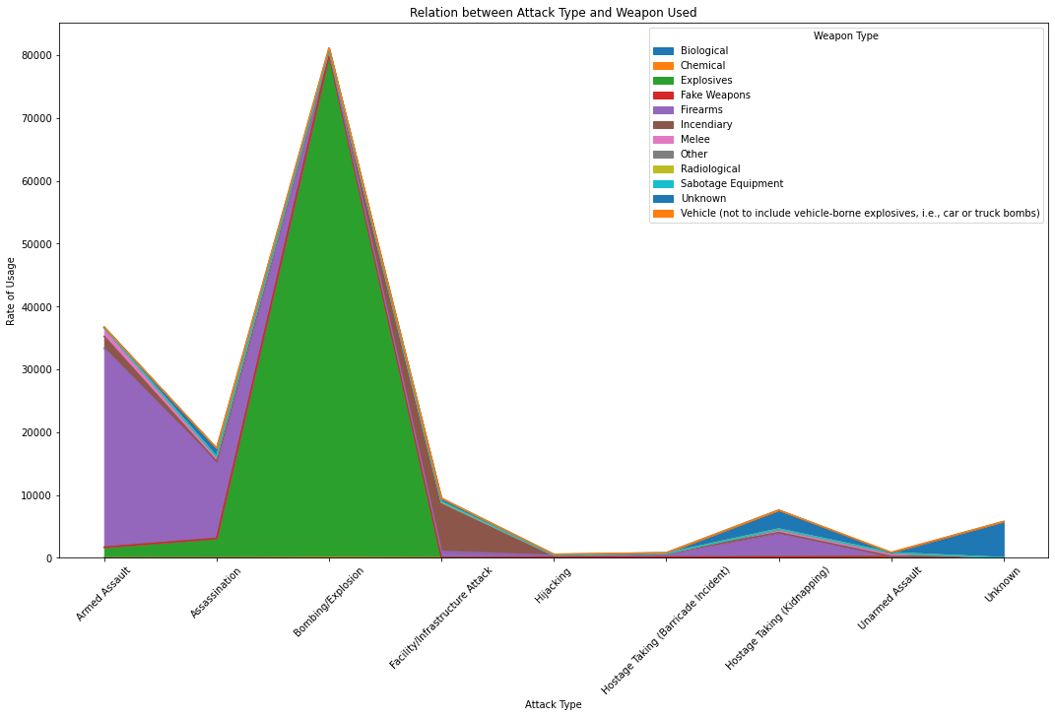
Here we found a Relation between the (Attack Type) and (Weapon Used) and also used 'area' plot for good frequency plotting and we can find out like that at kidnapping situation a lot of firearms are used according to the graph.

Slide 13
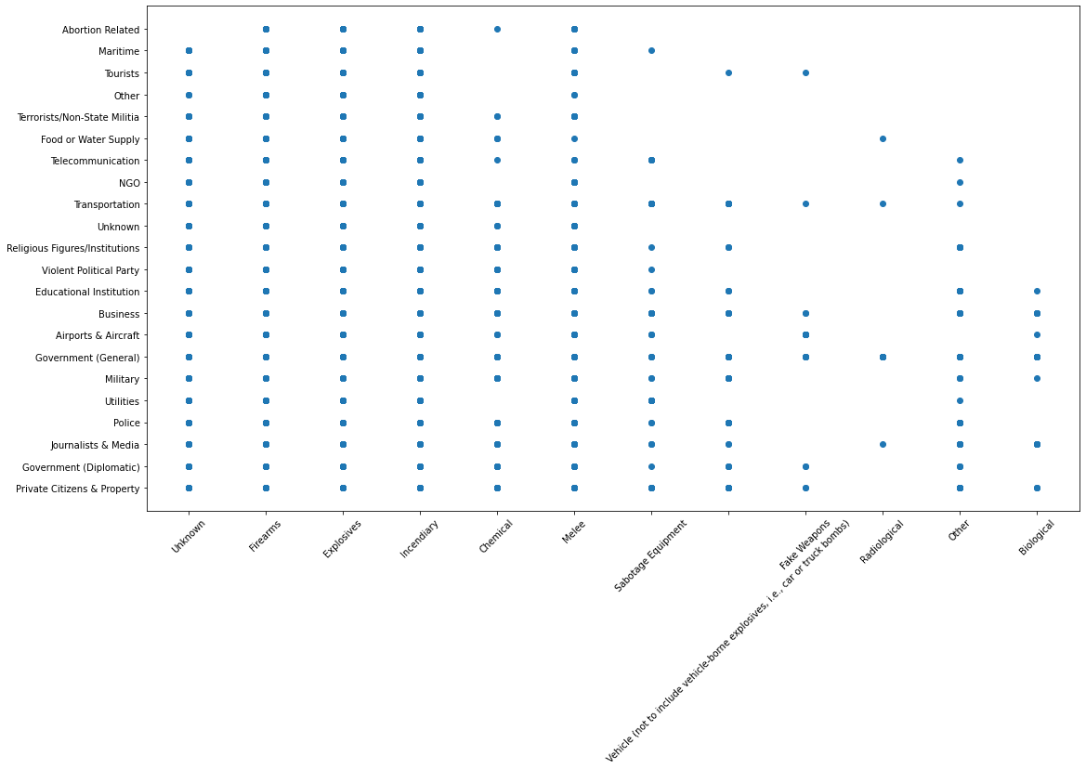
This graph to compare which weapons used on different targets. we used scatter plot just to get the (intersecting part) not for (quantity).
From the graph we can find out that explosives and firearms are actually used approximately on every target.

Slide 14
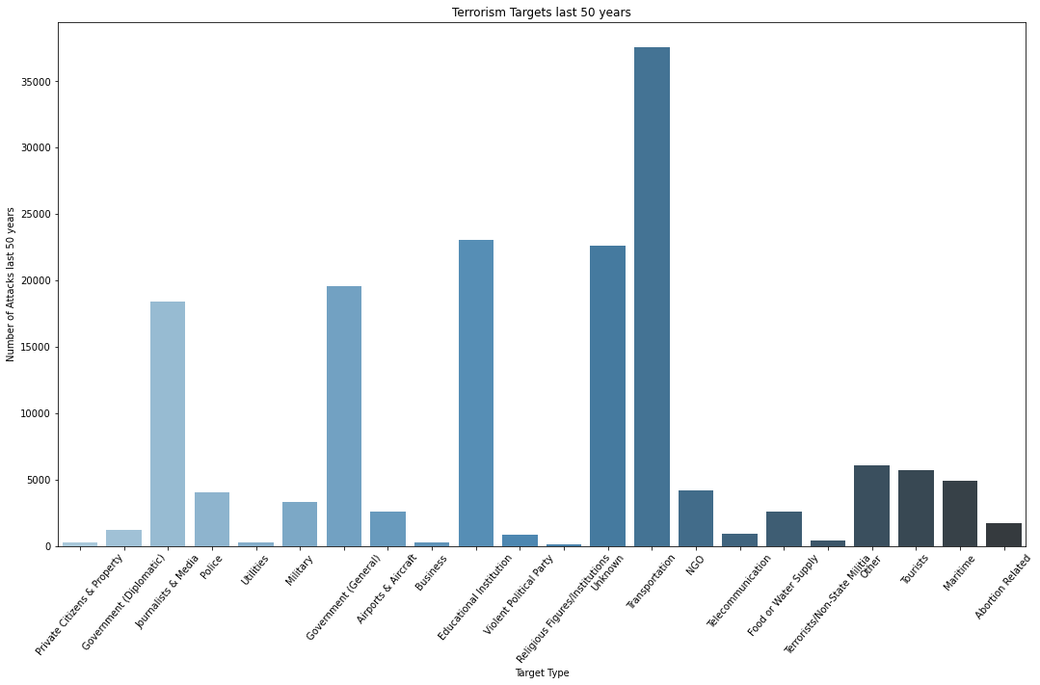
We used the barplot for visualization of the (number of attacks last 50 yeasr) to compare their values and the (targeted places) targeted places on the x-axis while values on y-axis. From the graph we can find out that transportation is the most targeted place in last 50 years.

Slide 15
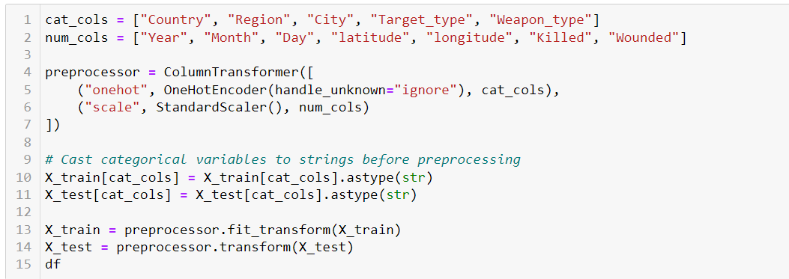
Normalization
We start by initializing
a Standard Scaler object.
The This helps in standardizing the dataset that is essential before applying machine learning
algorithms.

Slide 16
Normaliztion
Calculation of Mean and Standard Deviation: The first step in StandardScaler normalization is to calculate the mean (μ) and standard deviation (σ) of the feature or variable to be normalized. The mean represents the average value of the feature, while the standard deviation measures the spread or dispersion of the values.
Centering the Data: In this step, the mean value of the feature is subtracted from each data point to center the data around zero. This process helps in removing any bias or offset in the data.
Scaling the Data: After centering the data, the next step is to divide each data point by the standard deviation. This scaling operation ensures that the data has a standard deviation of 1. It effectively transforms the data to have a unit variance

Slide 17
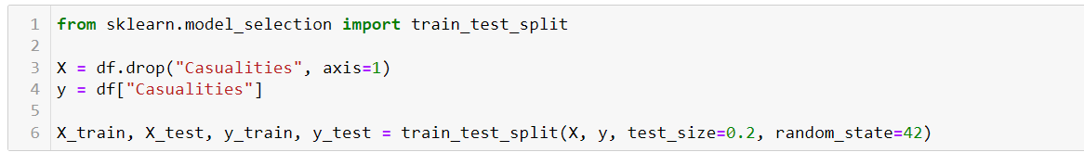
Split
This function is used to split the given data X and y into training and testing sets
test_size=0.2 specifies that 20% of the data will be used for testing, while the remaining 80% will be used for training.

Slide 18

Algorithm

Slide 19
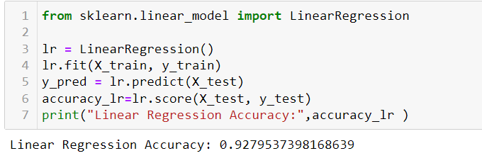
LinearRegression
Linear regression is a widely used statistical technique for modeling the relationship between a dependent variable and one or more independent variables. It assumes a linear relationship between the variables, where the dependent variable can be predicted or explained by a linear combination of the independent variables. Linear regression is a parametric approach, meaning it makes certain assumptions about the data and seeks to estimate the parameters that best fit the data

Slide 20
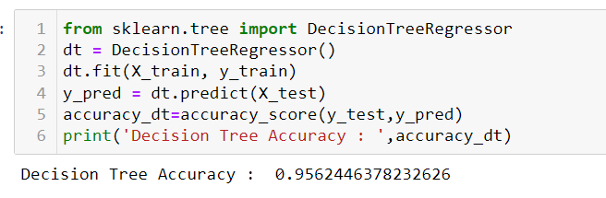
Decision Tree
A Decision Tree is a popular supervised machine learning algorithm used for both classification and regression tasks. It is a non-parametric model that predicts the target variable by learning simple decision rules inferred from the data features. The Decision Tree algorithm builds a tree-like model where each internal node represents a feature or attribute, each branch represents a decision rule, and each leaf node represents an outcome or class label

Slide 21

Conclusion
Decision Tree
is Evaluation more than Linear Regression

Slide 22
Resources:
https://www.kaggle.com/
https://www.start.umd.edu/gtd/
YouTube

Slide 23

Thank you

